Slide 1


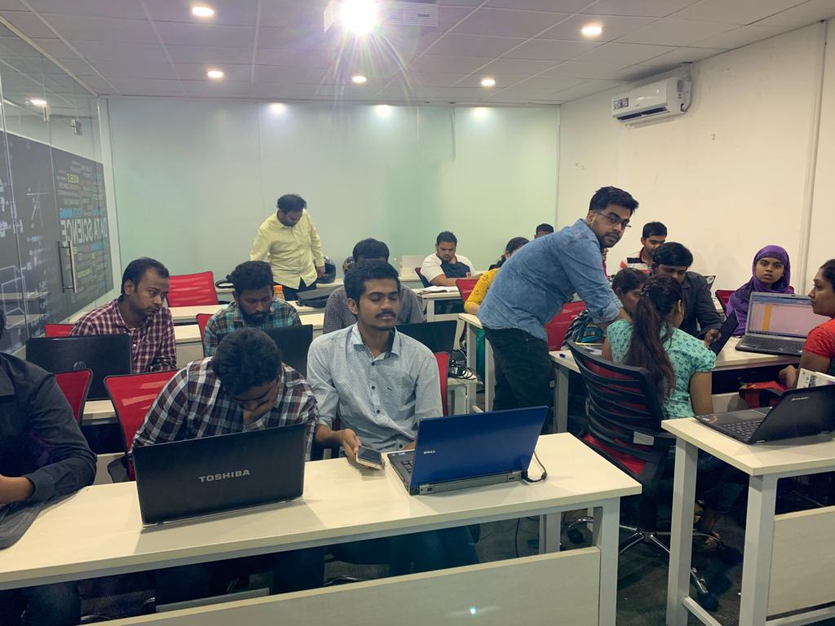

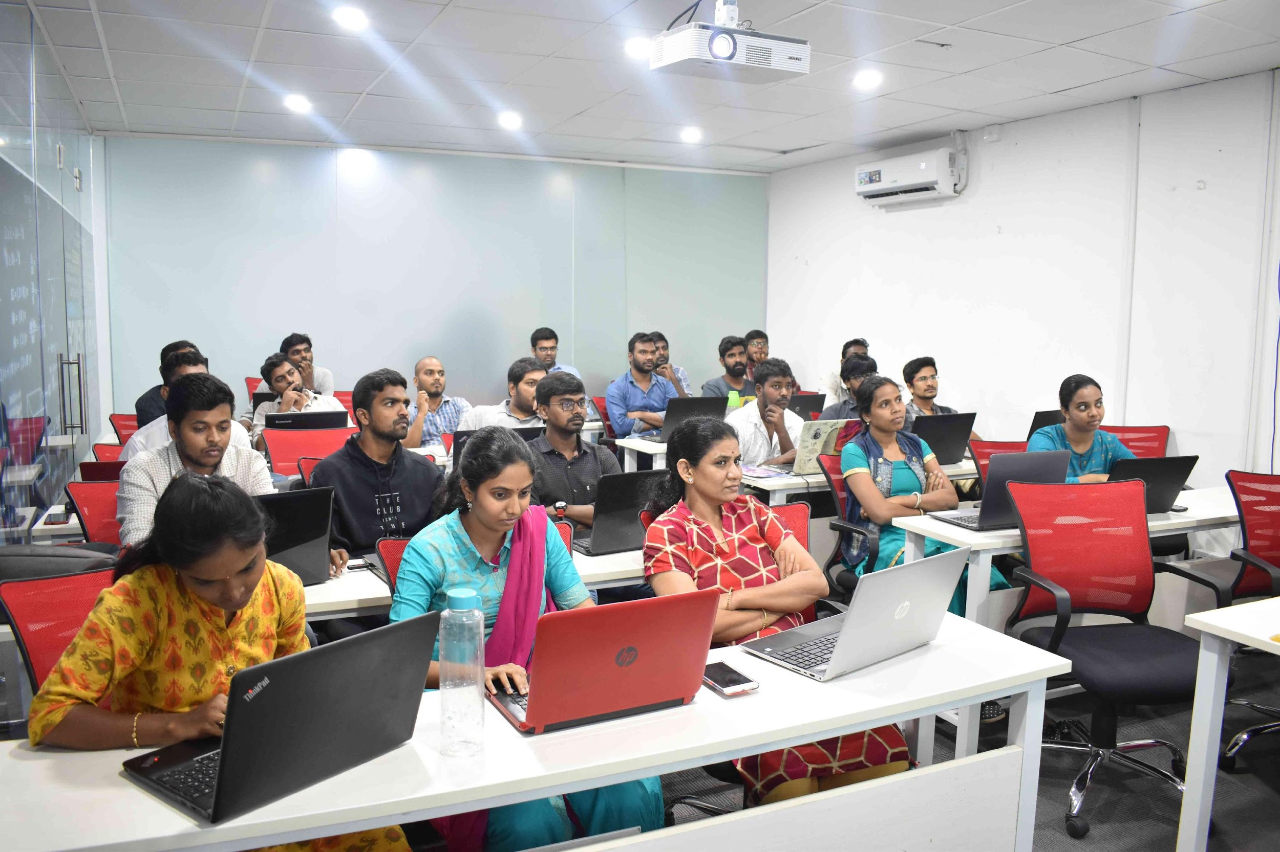

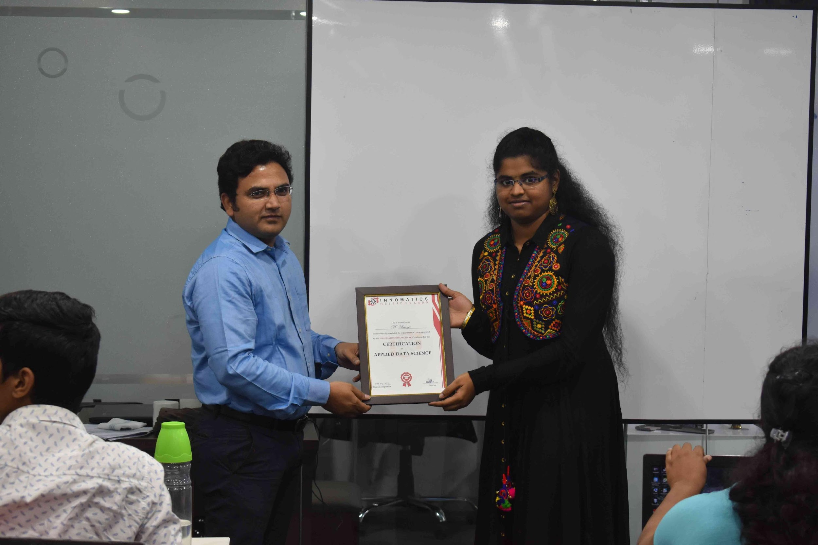
1

Slide 2



Slide 3
ABOUT TEAM:
Name:Sravani
Qualification :MSc Computer Science

Slide 4
IMPORT LIBRARIES:
Beautiful Soup(bs4)
Requests(HTTP lib)
re
Matplotlib
Seaborn
NumPy
Pandas
Plotly

Slide 5
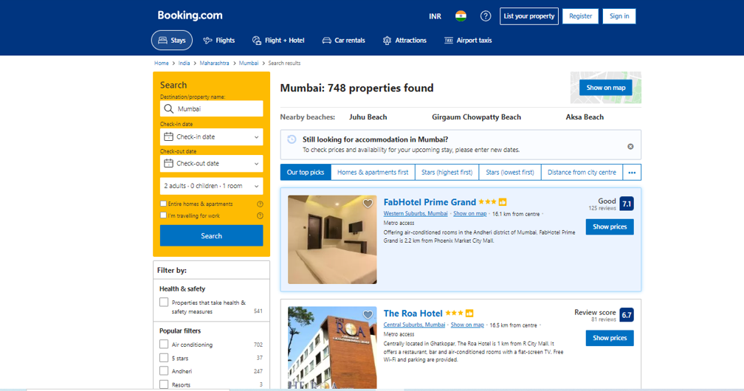
WEBSITE:

Slide 6
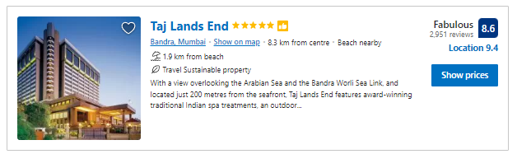
FEATURES:
Hotel
Price
BD Price
Free cancel
Discount
Meals
1D Bed
2 S Bed
XL Bed
Rating
Room type
City
Review
Metro

Slide 7
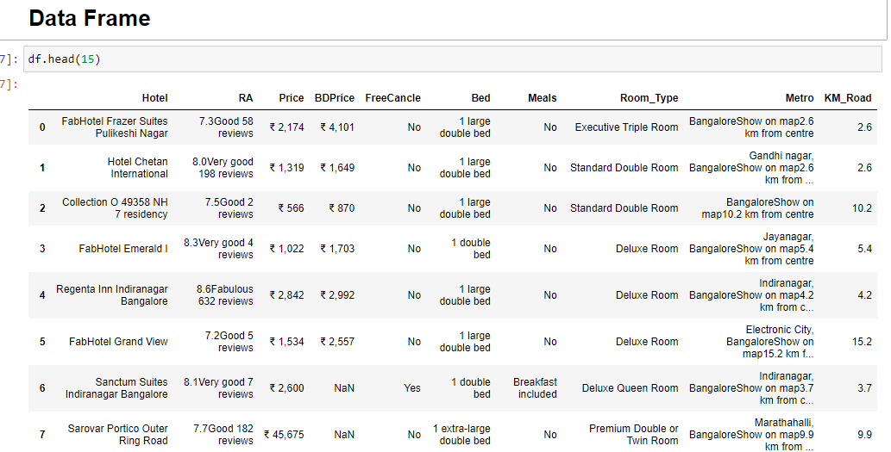
PROJECT DETAILS

Slide 8
DATA CLEANING
Identifying Null Values.
Identifying Missing Values.
Treating rows and columns with null values and missing values.
Extracting required data using regular expressions.
Converting required columns from object to int or float datatype.
Drop unwanted columns.

Slide 9
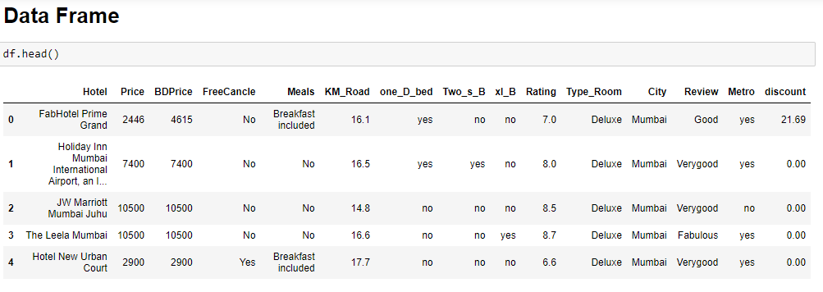
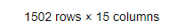
DATA FRAME AFTER DATA CLEANING

Slide 10
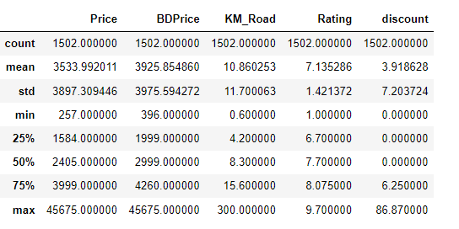
STATISTICS OF DATA FRAME

Slide 11

VISUALISATION

Slide 12
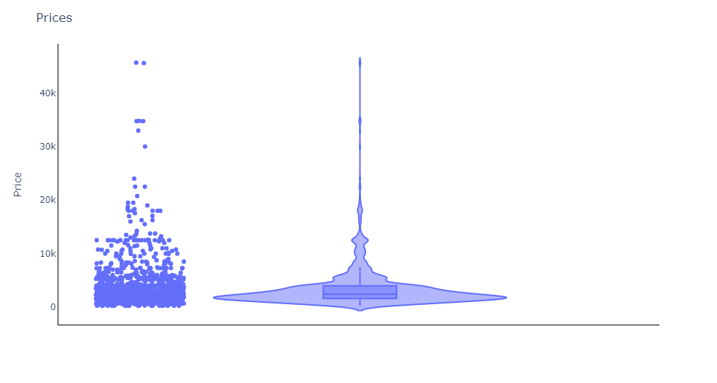
VISUALISING PRICE WISE
OBSERVATION:
The most of the Rooms in
Booking.com are in between 1200
to 4200 price range for
1 night 2 Adults.
We can also see 2 hotels as
outliers , which chargers very
high

Slide 13
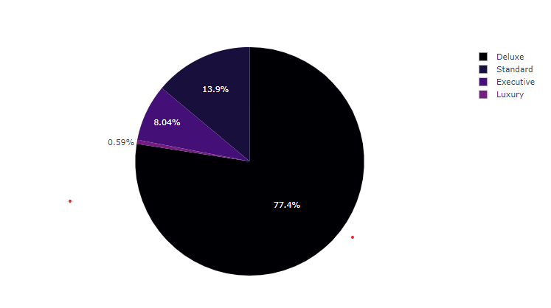
VISUALISING ROOM WISE
77.4% are belongs to Deluxe Rooms
13.9% are belongs to Executive Rooms
8.04% are belongs to Standard Rooms
0.59% are belongs to Luxury Rooms

Slide 14
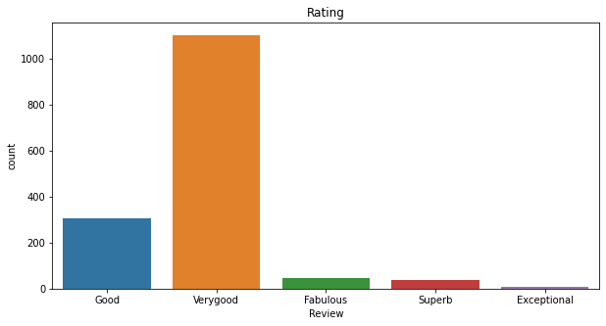
VISUALISING RATING WISE
OBSEVATION:
Most of the Hotels are having very good
rating
Very less Hotels are having Exceptional
rating

Slide 15
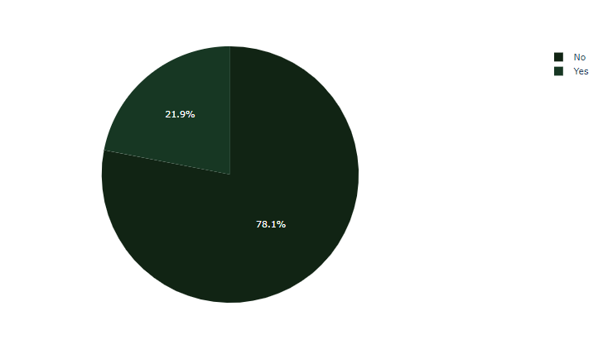
VISUALISING FREE CANCEL WISE
OBSEVATION:
78.1% of the hotels are not having
free cancel
21.9% of the hotels are having free cancel

Slide 16
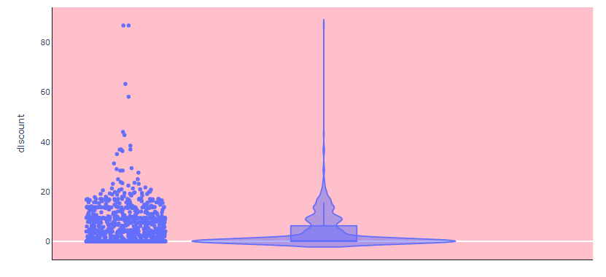
VISUALISING DISCOUNT PERCENTAGE WISE
OBSEVATION:
Most of the hotels are providing only below20% of discount.

Slide 17
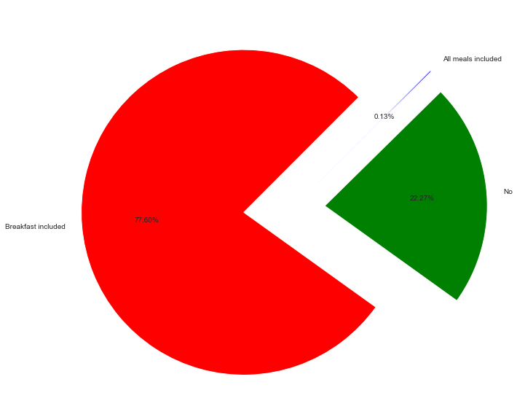
VISUALISING MEALS WISE
OBSEVATION:
77.60% is providing breakfast
22.27% is not providing anything
0.13% is providing all meals.

Slide 18
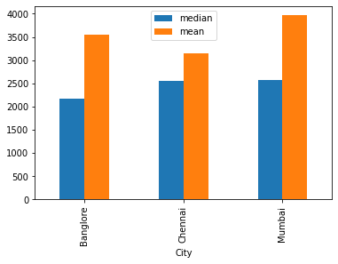
CITY VS PRICE
OBSEVATION:
Mumbai is charging high for rooms
compare with others
Chennai is charging low for rooms
compare with others

Slide 19
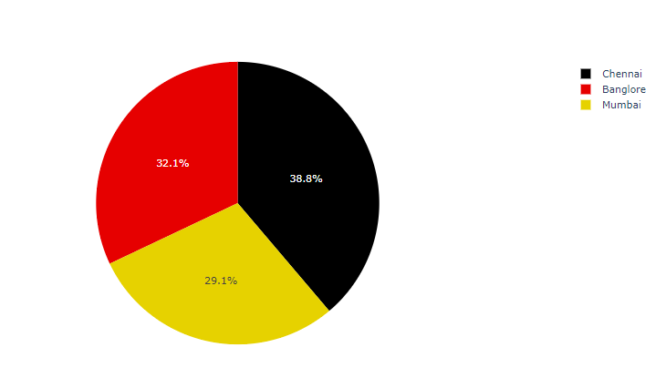
CITY VS RATING
OBSEVATION:
Chennai is stands first in rating ,
Where as Mumbai stands last in rating

Slide 20
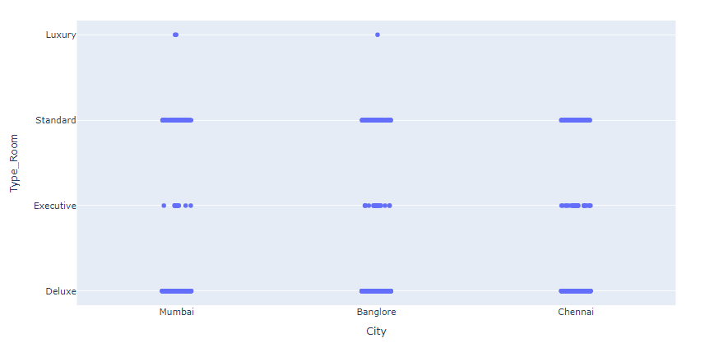
CITY VS ROOM TYPE
OBSEVATION:
All type of rooms available in Bengaluru
Luxury rooms are not available in Chennai

Slide 21
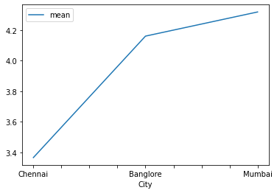
CITY VS DISCOUNT
OBSEVATION:
Discount percentage of Mumbai is high compare with Chennai Bengaluru.

Slide 22
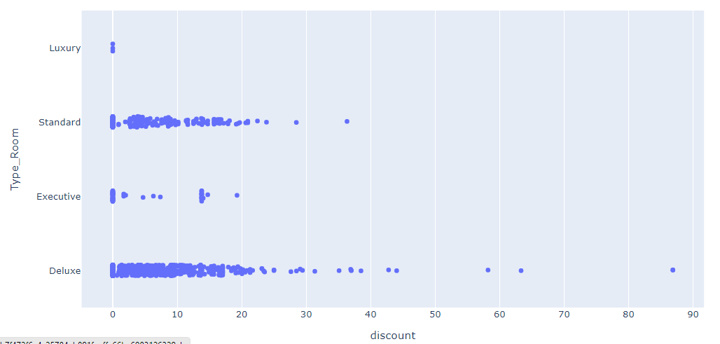
ROOM VS DISCOUNT
OBSEVATION:
Deluxe room type has more discount percentage.
2ND Standard room type more discount percentage
Mumbai is charging high for all types of beds
Executive has less where as Luxury Room has no discount percentage

Slide 23
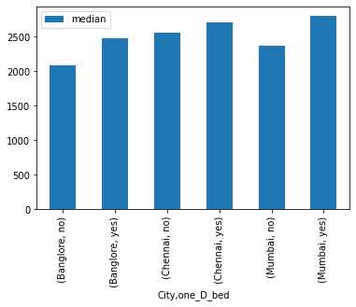
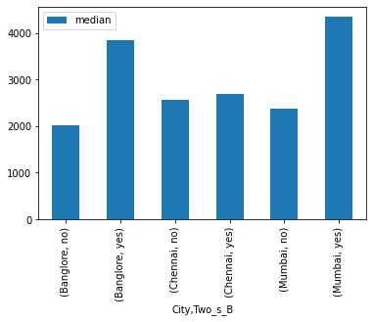
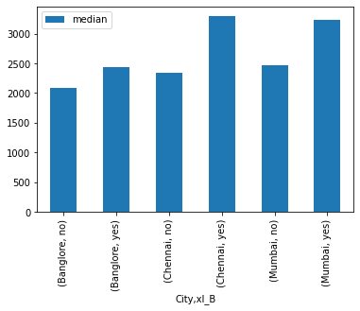
CITY VS BED VS PRICES
OBSEVATION:
Two Single Bed. Price is greater than others
Mumbai is charging high for all types of beds
1 Double Bed cost is less compare to all

Slide 24
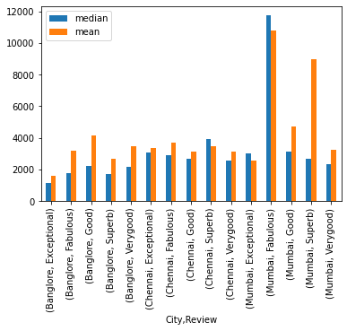
CITY VS REVIEW VS PRICES
OBSEVATION:
Mumbai , Fabulous hotels are charging high price.
Next Mumbai , Superb hotels are charging high price
In every city Exceptional is charging low price

Slide 25
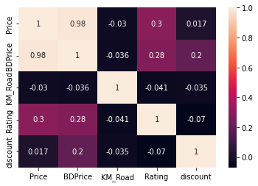
CORRELATION MATRIX
OBSEVATION:
Price and BDPrice are highly correlated.
cancel and Rating is negatively correlated.

Slide 26
FUTURE SCOPE
We can analyse the data with location, and predict which location in the city will reach to your budget

Slide 27


